Slide 1
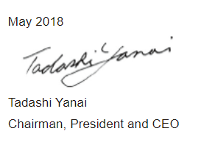
Peculiarities of business development on Russian market:
UNIQLO example
Changing clothes. Changing conventional wisdom. Change the world. This corporate statement embodies our commitment to make the world a better place, and our determination to operate a business that prioritizes our customers and enriches our society.
SPBU World’s economy department PhD student Subbotina Ksenia

Slide 2
Company’s info
Name | ООО «ЮНИКЛО (РУС)»
Foundation | 29 January 2009
Address | Москва, Россия 105064, Россия, г.Москва, ул.Земляной Вал, д.9, стр.1 БЦ «СитиДелл»
Type of business | Retail chain of everyday clothes of UNIQLO brand in Russia
Source: http://www.fastretailing.com/

Slide 3
Fast Retailing Group: 1. GU 2. Theory 3. COMPTOIR DES COTONNIERS 4. PRINCESSE TAM.TAM 5. J Brand
Units: Stores |  |  | As of | As of | As of | As of | As of | As of
 |  |  | November 30, | February 28, | May 31, | August 31, | November 30, | February 28,
 |  |  | 2016 | 2017 | 2017 | 2017 | 2017 | 2018
UNIQLO Operations |  |  | 1,85 | 1,861 | 1,905 | 1,92 | 1,974 | 1,989
 | UNIQLO Japan: |  | 841 | 832 | 834 | 831 | 833 | 828
 |  | Own Stores | 800 | 791 | 793 | 790 | 791 | 787
 |  | Large-scale | 207 | 206 | 209 | 209 | 214 | 214
 |  | Standard | 593 | 585 | 584 | 581 | 577 | 573
 |  | Franchise | 41 | 41 | 41 | 41 | 42 | 41
 | UNIQLO International: |  | 1,009 | 1,029 | 1,071 | 1,089 | 1,141 | 1,161
 |  | China | 497 | 514 | 540 | 555 | 576 | 592
 |  | Hong Kong | 25 | 25 | 25 | 25 | 27 | 28
 |  | Taiwan | 63 | 64 | 65 | 65 | 65 | 65
 |  | Korea | 178 | 178 | 180 | 179 | 181 | 181
 |  | Singapore | 25 | 25 | 24 | 24 | 25 | 26
 |  | Malaysia | 35 | 37 | 39 | 41 | 43 | 43
 |  | Thailand | 34 | 34 | 34 | 34 | 35 | 35
 |  | Philippines | 34 | 35 | 37 | 40 | 45 | 47
 |  | Indonesia | 10 | 10 | 11 | 12 | 14 | 14
 |  | Australia | 12 | 12 | 12 | 12 | 13 | 14
 |  | USA | 49 | 48 | 47 | 44 | 46 | 45
 |  | Canada | 2 | 2 | 2 | 2 | 3 | 3
 |  | UK | 10 | 10 | 10 | 10 | 11 | 11
 |  | France | 15 | 15 | 19 | 19 | 22 | 22
 |  | Russia | 14 | 14 | 19 | 20 | 25 | 25
 |  | Germany | 4 | 4 | 5 | 5 | 5 | 5
 |  | Belgium | 2 | 2 | 2 | 2 | 3 | 3
 |  | Spain | 0 | 0 | 0 | 0 | 2 | 2
GU |  |  | 357 | 358 | 374 | 372 | 383 | 384
Global Brands |  |  | 1,014 | 1,002 | 1,016 | 1,002 | 1,009 | 997
 | Theory* |  | 529 | 524 | 541 | 538 | 545 | 540
 | COMPTOIR DES COTONNIERS* |  | 348 | 342 | 342 | 333 | 332 | 328
 | PRINCESSE TAM.TAM* |  | 137 | 136 | 133 | 131 | 132 | 129
Total |  |  | 3,221 | 3,221 | 3,295 | 3,294 | 3,366 | 3,37

Slide 4
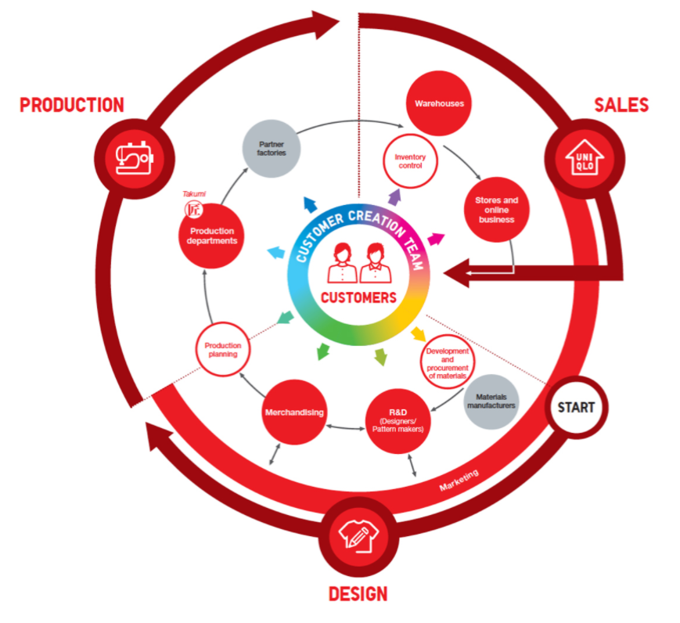
UNIQLO’s business model
Design
Production
Sales

Slide 5
Research & Design (Designers/Pattern makers)
UNIQLO's R&D centers continually research the latest new materials and the latest global fashions. Roughly one year before a product's intended launch, the R&D department holds a concept meeting with representatives from the merchandising, marketing and materials development teams to determine the right design concept. Designers then prepare designs and refine samples. Even after a design is decided, its color and silhouette can be refined multiple times before it is finalized
Merchandising
Merchandisers play a vital role in the product creation process, from design through production. They communicate closely with many other departments before determining the planning, design, materials and marketing approaches required to satisfy predetermined seasonal concepts. Merchandisers decide product lineups and production volumes for the fall, winter, spring and summer seasons. Many UNIQLO products are manufactured in mass lots of approximately one million items. Merchandisers also closely monitor sales levels and decide whether to increase or reduce production for particular items during a season.

Slide 6
Development and Procurement of Materials
UNIQLO can secure stable, high-volume supplies of top-quality materials at low cost by negotiating directly with materials manufacturers and placing large-volume orders. The materials used for our core items are particularly important. Our in-depth research and experimentation generates multi-layered improvements in the functionality, feel, silhouette and texture of our clothes. For example, we work closely with the denim industry's reputed Kaihara Corporation to source denim of specific spinning standards and dyeing specifications. We also partner with Toray Industries, a world-leading synthetic fiber manufacturer, to create innovative high-function materials and products such as HEATTECH.
Production Department
UNIQLO currently deploys about 450 production team staff and textile takumi (skilled artisans) to production offices in Shanghai, Ho Chi Minh City, Dhaka, Jakarta, Istanbul and Bangalore. Production teams visit partner factories each week to resolve outstanding issues. Customer concerns regarding quality are communicated immediately to Production Departments, and improvements are made.

Slide 7
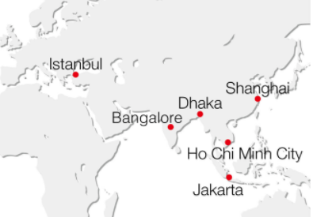
Production Network
As UNIQLO expands globaly, we have formed business relationships with partner factories in China, Vietnam, Bangladesh and Indonesia. We are looking to expand our manufacturing base by developing relationships with factories closer to UNIQLO stores in Europe, the United States and eleswhere.

Slide 8
Inventory Control
The Inventory Control Department maintains the optimum level of store inventory. It does this by monitoring sales and stock on a weekly basis, and dispatching necessary inventory and new products to fulfill orders. At the end of each season, merchandisers and the Marketing Department work together to coordinate the timing of any price changes to help ensure that inventory sells out.
Marketing
Each season, UNIQLO conducts promotional campaigns for core products such as fleece, Ultra Light Down jacket, AIRism and HEATTECH. During the campaigns, UNIQLO advertises the products' unique qualities and noteworthy features on TV and in other media. In Japan, for example, weekly flyers in the Friday edition of national newspapers, which are delivered to most households, announce week-long 20-30% off campaigns to promote new items.

Slide 9
Stores
UNIQLO Japan had 831 stores (including 41 franchise stores) at the end of August 2017. UNIQLO International has expanded to 1,089 stores, including 645 in Greater China (Mainland China, Hong Kong and Taiwan), 179 in South Korea, 163 in Southeast Asia & Oceania, 56 in Europe and 46 in the North America. New store openings have been especially rapid in Greater China and Southeast Asia
Online Sales
Online sales are increasingly important. In Mainland China and the United States, these sales account for over 10% and 20% of our total revenue, respectively. In Japan, online sales accounted for 48.7 billion yen, or 6.0% of the total, in FY2017. There, we have improved our online services by enabling customers to collect online purchases from nearby convenience stores or UNIQLO locations. We are looking to expand online sales worldwide by offering a fuller range of exclusive online products, special online sizes and semi-order-made goods.
Customer Insight Team
Our customer insight team is growing in importance every year. It uses big data--including product comments, purchase trends and requests submitted to our Customer Center and made online--and analyzes this information to predict demand and make product improvements. UNIQLO production often continues into the selling season, and demand predictions help us make effective mid-season judgments and adjustments. The information gained through data analysis also helps us to create the products customers most desire.

Slide 10
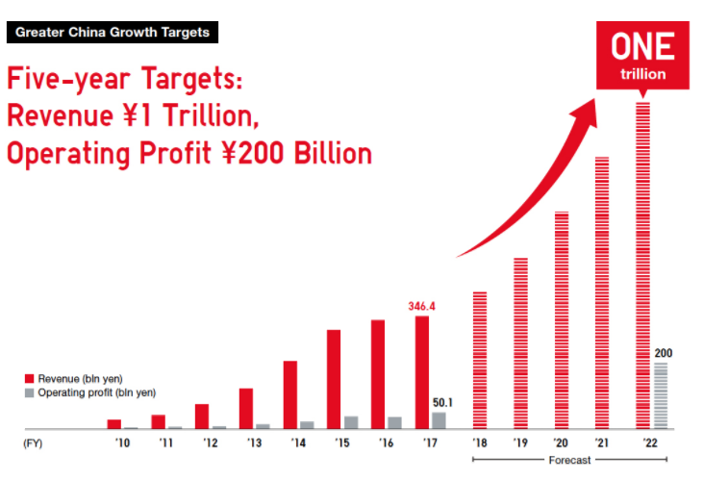
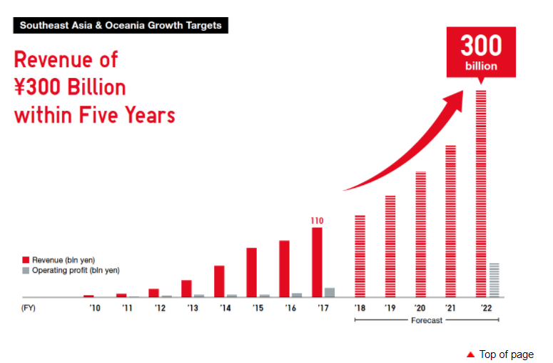
UNIQLO Business Strategy

Slide 11
UNIQLO operation stores in Russia
Москва
UNIQLO Vegas Кунцево
UNIQLO ТРЦ Хорошо
UNIQLO Золотой Вавилон Ростокино
UNIQLO Гудзон
UNIQLO Калейдоскоп
UNIQLO Ривьера
UNIQLO Океания
UNIQLO Авиапарк
UNIQLO МЕГА Теплый Стан
UNIQLO Метрополис
UNIQLO Columbus
UNIQLO Европейский
UNIQLO Охотный ряд
UNIQLO МЕГА Химки
UNIQLO Отрада
UNIQLO МЕГА Белая Дача
UNIQLO Атриум
Санкт-Петербург
UNIQLO Охта Молл
UNIQLO Мега Парнас
UNIQLO ТРК Радуга
UNIQLO ТРК Лето
UNIQLO МЕГА Дыбенко
UNIQLO Галерея
Нижний Новгород
UNIQLO МЕГА Нижний Новгород
UNIQLO Фантастика
Казань
UNIQLO МЕГА Казань
Ростов-на-Дону
UNIQLO Мега Ростов-на-Дону
UNIQLO Горизонт

Slide 12
Perspectives on Russian markets
Fast Retailing Co., Ltd. and Mitsubishi Corporation have agreed to turn Limited Liability Company UNIQLO (RUS), Fast Retailing’s subsidiary operator of the UNIQLO brand in Russia, into a joint corporation through issuance of new shares to Mitsubishi Corporation.
Following the issuance of new shares, Fast Retailing will own a 75% stake and Mitsubishi Corporation will hold a 25% stake in UNIQLO (RUS).
“We think that there are four countries whose importance globally will be increasing and that are important for us. First China, then Russia, Brazil and India,” Otoma said through a translator.
Mr. Naoki Otoma is Chief Executive Officer at Fast Retailing (Singapore) Pte. Ltd., Chief Operating Officer & Director at Uniqlo Co.

