Slide 1
The world trading system and US-China trade war
Cheng dawei
School of Economics
Renmin University of China

Slide 2
ISSUEs
China’s state-led, market-distorting economic model presents a challenge to U.S. economic and national security interests. The Chinese government, directed by the Chinese Communist Party (CCP) leadership, continues to exercise direct and indirect control over key sectors of the economy and allocate resources based on the perceived strategic value of a given firm or indus- try. This puts U.S. and other foreign firms at a disadvantage— both in China and globally—when competing against Chinese companies with the financial and political backing of the state.

Slide 3
ISSUes: Deficit
Trade deficit issues: The United States posted a record trade deficit in goods with China in 2017 ($375.6 billion), and is poised to exceed that total in 2018. Through the first eight months of 2018, the U.S. goods deficit was up 9 percent compared to the same period in 2017.

Slide 4
Issues: Industrial policy(1)
Industrial policy: High-tech industries such as artificial intelligence (AI), biotech- nology, and virtual reality have been the primary targets of Chinese VC activity in the United States.
From 2014 to the third quarter of 2017, Chinese investors were involved in $1.2 billion of VC financing for U.S. AI firms

Slide 5
Issues: Industrial policy(2)
In its 2017 report to Congress on China’s WTO compliance, the Office of the U.S. Trade Representative (USTR) said the United States has strong concerns regarding the direction of the Chinese government’s industrial policies, specifically those that:
Discriminate against U.S. firms or products;
Encourage “excessive government involvement in determining market winners and losers”;
Are tied to export, localization, or local IP targets; or
Lead to subsidization or technology transfer.6
Such policies appear particularly strong in “strategic and emerging industries” identified for development, where Chinese companies must meet ambitious government-set market share targets.

Slide 6
Issues: IP
Intellectual property theft, technology transfer, and econom-ic espionage: The United States has several regulatory tools available to address Chinese technology transfer requirements and IP theft.

Slide 7
Issues: Digital trade
Data localization and cross-border data transfer restrictions: China’s recent effort to localize and restrict the flow of data across borders poses significant challenges to U.S. and other foreign businesses, who fear the regulatory burden of duplicat- ing information technology services to separate and store data in China. China’s Cybersecurity Law, implemented in 2017, re- quires personal information held by “critical information infra- structure” to be stored on servers in China, and data deemed important require a “security assessment” before they can be transferred abroad.

Slide 8
Issues: National security and Investment
The Committee on Foreign Investment in the United States (CFIUS) oversees the review of inbound FDI for national security threats.

Slide 9
ISSues: Country Identity
China developing or developed country?

Slide 10
US-China war map
Trade
Industry
Rule-making
World order

Slide 11
China’s principles
WTO system
Free trade--development
Negotiation is best solution

Slide 12
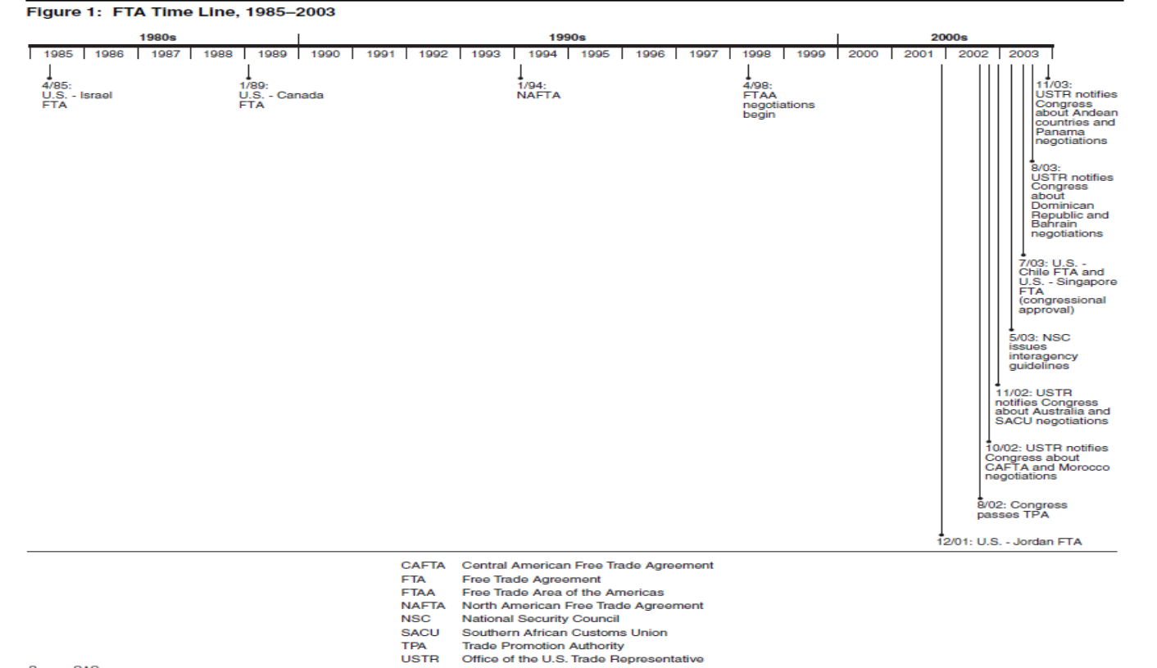
Crisis of current trading system

Slide 13
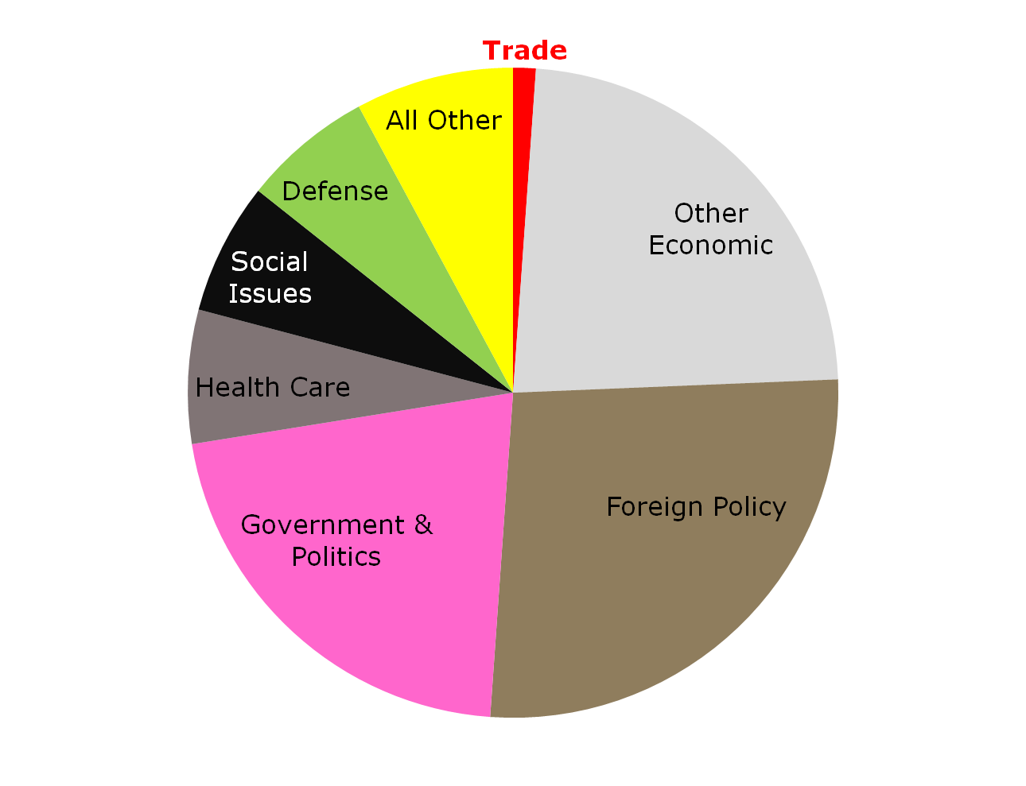
Trade Has Taken Up a Small Fraction of President Obama’s Time
As of September 29, 2009, he dealt with 1068 topics in 934 events. Trade policy was at issue 12 times (1.1% of the 1068).
Source: Calculated from the Washington Post’s POTUS Tracker

Slide 14
Peter Navarro(the National Trade Council): ‘economic aggression.’
The White House report begins by describing four categories of China's economic aggression: (1) protect China's home market from imports and competition; (2) expand China's share of global markets; (3) Secure and control core natural resources globally; and (4) dominate traditional manufacturing industries. It says concrete measures include the physical and cyber-enabled theft of technologies and intellectual properties; the evasion of U.S. export control laws by counterfeiting, piracy and reverse engineering; systematically harvesting public information and technical achievements; and deploying Chinese students and visiting scholars as technology spies

Slide 15
What is Lighthizerism?
Lighthizerism scorns the multilateral approach in favor of bilateralism, or deals between two nations to lower barriers.
Lighthizer may focus on two things theoretically: first, he may deny MFN principle which is core of the WTO rules, he will prefer to use reciprocity as basic principle of trade law. Second, he uses protectionism in pursuit of free trade, which is the so-called "fair trade".

Slide 16
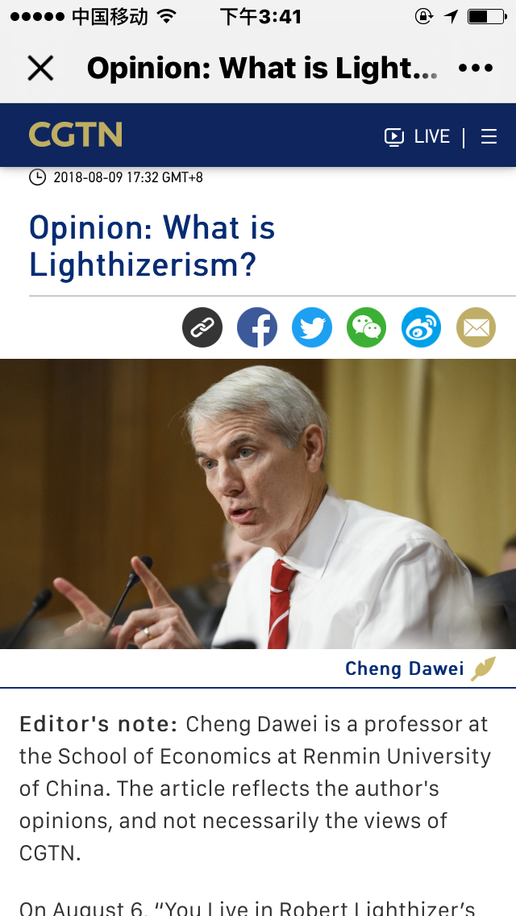
My paper

Slide 17
Our future task
Re-start WTO talks as soon as possible
Create new rules
Work together on some issues

